Slide 1

PORTFOLIO
01 / 38
Abdullah Chaudary_
I architected the AI product that became the main
selling point of a
$600M+
acquisition.
Senior Full-Stack Engineer | Systems & DevSecOps Architect | Tech Lead | AI/ML Engineering
abchaudary.me

Slide 2
ACQUISITION
ABDULLAH CHAUDARY
02 / 38
$600M+
The AI product I wrote the proposal for, architected alone and led to production was the main selling point of the acquisition.

Slide 3
WHO I AM
03 / 38
12+ years building and securing production platforms
Proposal, architecture, hardware, build, security, deploy, uptime. End-to-end ownership of web and mobile products across AWS, GCP, Azure and self-hosted environments.
$600M+
99.95%
~70%
Up to 20
acquisition
uptime
infra cost cut
teams of up to 20
INDUSTRIES SHIPPED INTO
pharma
marketing research
healthcare
EdTech
FinTech
logistics
real estate
government
business tools

Slide 4
WHAT I DO
04 / 38
Four core disciplines
01
02
Full-stack product engineering
DevSecOps and platform architecture
Next.js · React · React Native · Vue.js · Nuxt.js · Django · FastAPI · Express
AWS · GCP · Azure · Docker · Kubernetes · Terraform · Ansible · GitLab CI/CD
03
04
Self-hosted and production AI
Technical leadership
LLMs · RAG · Qdrant · Ollama · Qwen3 · MCP · agentic workflows · n8n
Teams of up to 20 · proposals that won the work · Jira and Git governance · AGENTS.md

Slide 5
LEADERSHIP
05 / 38
Leading teams, clients and delivery
01
Teams of up to 20 across 5 concurrent products
20
02
Proposals that won the work, including the one behind the $600M+ acquisition
03
Onboarding and client meetings end to end
04
Jira and Git governance
05
AGENTS.md engineering standards
06
Up to 10x client revenue on key initiatives
people led across 5 concurrent products

Slide 6
01
06 / 38
01
01
DRIEVERSE AI
02
ACCOUNTAIRE FINTECH
03
SKILLSVERX
04
SEO TOOLKIT SAAS
05
ACCOUNTAIRE
06
DRIEVERSE
07
LEADSYFT
Products and platforms I built
08
DEVODIN
09
EXACT HARDWARE
Live products, each designed, built and deployed end to end.
10
THE SELF-HOSTED PLATFORM
11
ABCHAUDARY.ME

Slide 7
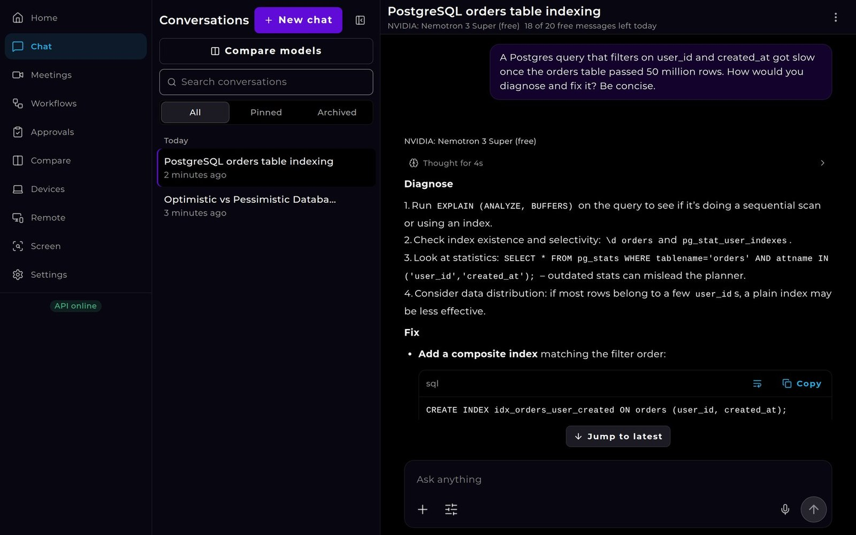
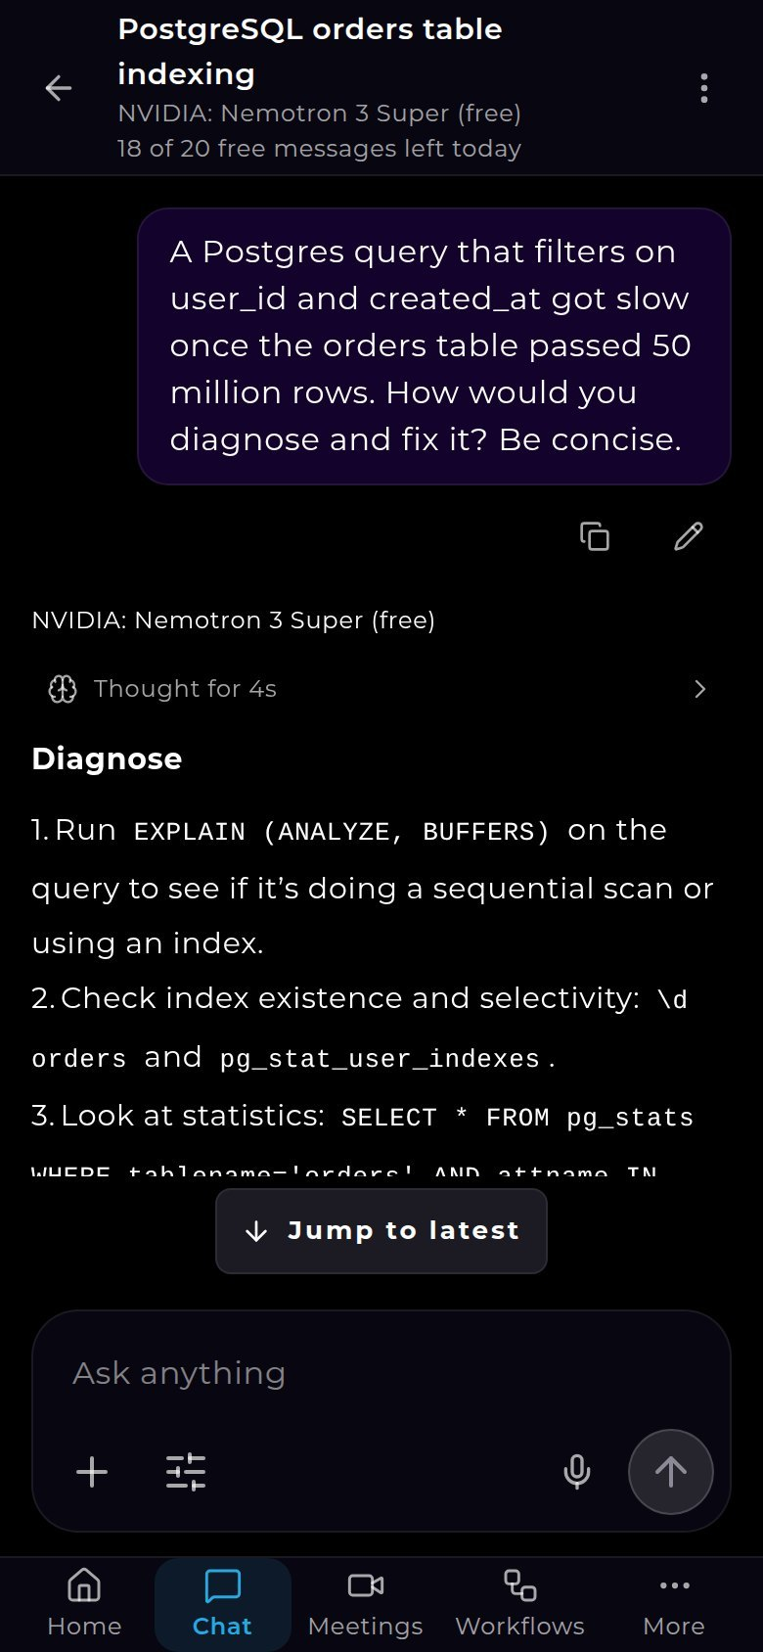
PRODUCT · AI
07 / 38
DrieVerse AI
A cross-platform AI assistant on seven model providers
ai.drieverse.com
Web, desktop and phone from one codebase
Meetings assistant
Screen context with on-device redaction
Dictation
Phone-to-desktop remote control
Agentic workflows with approvals

Slide 8
PRODUCT · AI · ARCHITECTURE
08 / 38
DrieVerse AI
One codebase across web, desktop and mobile, with sandboxed agent runs
CLIENTS: ONE NEXT.JS 16 UI
Next.js in browser, Electron and Capacitor
Browser
Desktop
Phone
Next.js 16 UI
Electron shell
Capacitor shell
Express 5 API + BullMQ worker
Platform contract, shared test suite
MongoDB 8, Redis, Qdrant, S3
gVisor pod per workflow run
Express 5 API
jobs
Distroless read-only containers
Seven model providers
+ WebSocket gateway
BullMQ worker
Anthropic
OpenAI
Google Gemini
Mistral
S3 storage
Qdrant
xAI
MongoDB 8
Redis 7
compatible
vectors
DeepSeek
OpenRouter
OpenTelemetry
Agent workflows: gVisor-sandboxed Kubernetes
Prometheus metrics
one pod per run, default-deny networking
~318k
14,600+
43
5
lines of code
tests
ADRs
security reviews

Slide 9
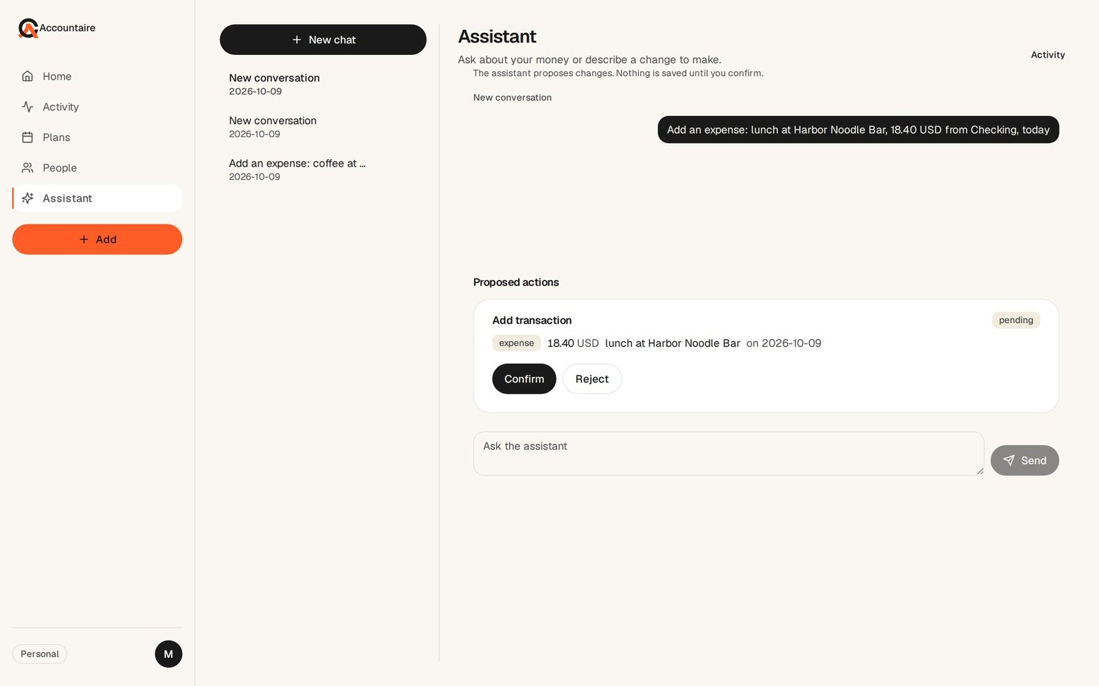
PRODUCT · FINTECH · AI
09 / 38
Accountaire FinTech
A multi-currency money app with a confirm-before-write AI assistant
app.accountaire.com
Multi-currency ledger with frozen FX
Receipts, bills, installments, lending
Bank import from email
AI assistant with 31 tools, every write confirmed by the user
Money rules enforced in code, services and 122 database checks
132
2,200+
6
endpoints
automated tests
CI jobs
Vue 3 SPA
Caddy
FastAPI
PostgreSQL
Supabase, OpenRouter
browser
single public entry
API, services, domain, repos
122 checks, triggers
Stripe, Postmark

Slide 10
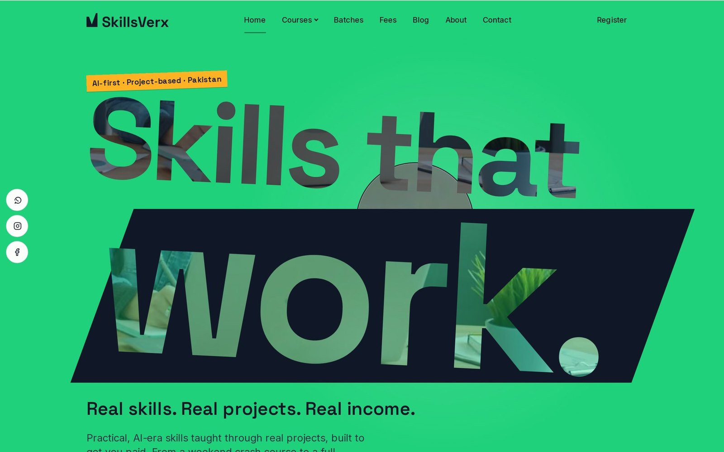
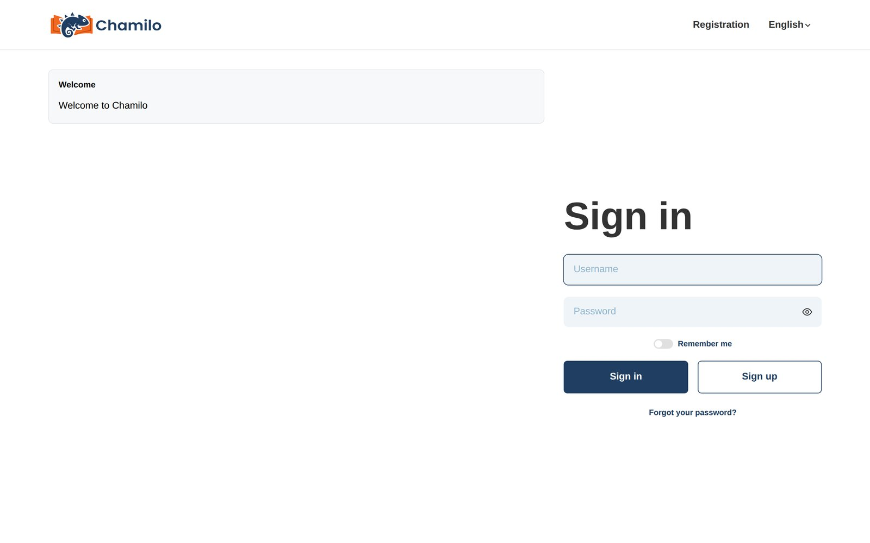
PRODUCT · EDTECH
10 / 38
SkillsVerx
An online academy with its own website, CMS and learning platform
skillsverx.com · lms.skillsverx.com
Cloudflare in front of the site and the LMS
WEBSITE AND CMS
LEARNING PLATFORM
LIVE CLASSES
Next.js 16 + Payload CMS 3
Chamilo LMS 3
plugin
BigBlueButton
one process, PostgreSQL 17
custom container, MariaDB 11
17 containers, DNS only
17-container BigBlueButton live classes
Next.js + Payload site with 40 course offerings, coupons and certificate verification
Chamilo LMS 3 in a custom container

Slide 11
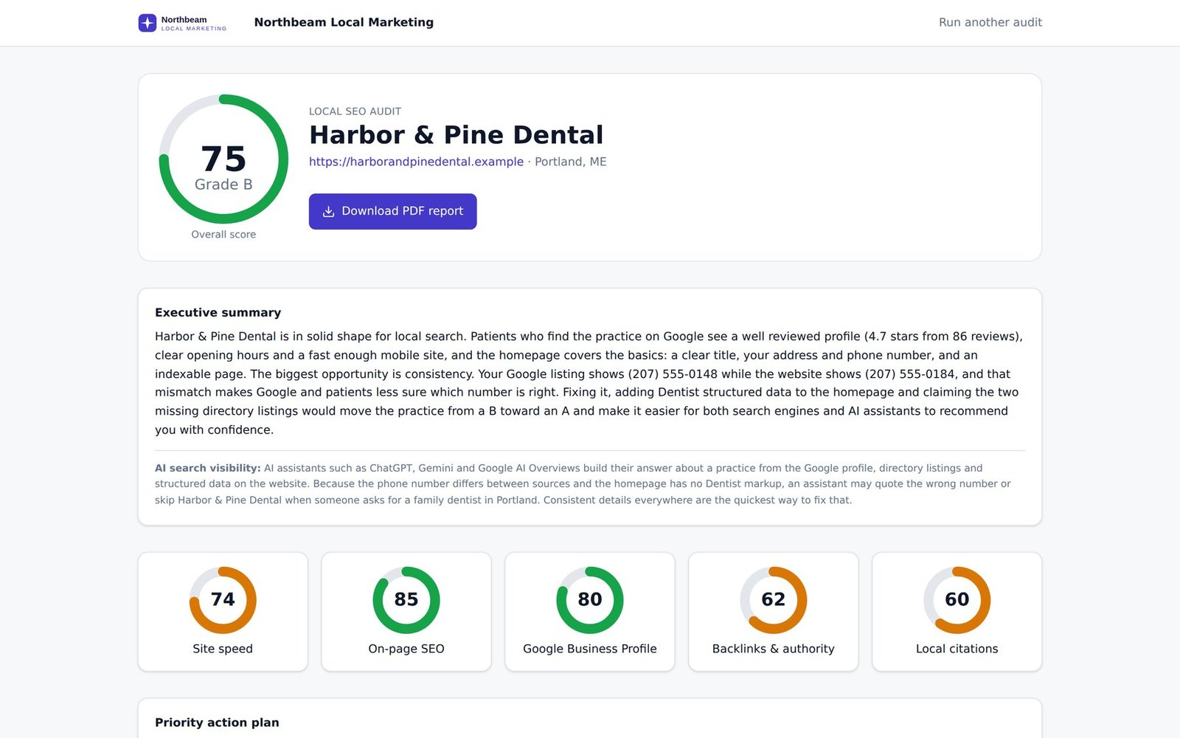
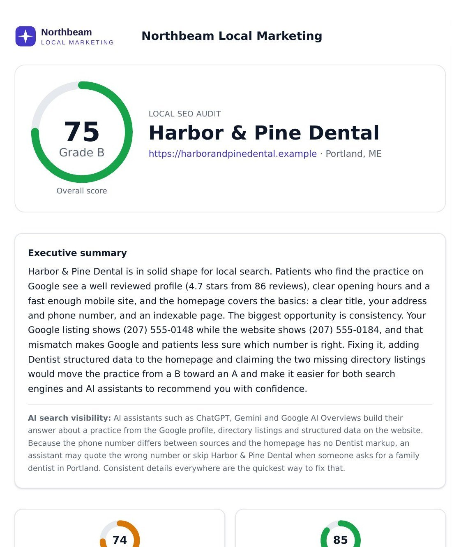
PRODUCT · SAAS · AI
11 / 38
SEO Toolkit SaaS
White-label Local SEO audits for agencies, generated live
seotools.abchaudary.me
White-labelled audit page per agency
Five weighted checks with graceful degradation
Live-filling report and branded PDF
Postgres queue and headless worker
Claude writes the summary, scoring stays deterministic
Business Profile
Site speed
On-page
Backlinks
Citations
Prospect
Next.js 15
Postgres
Worker
Five checks
Claude
Branded PDF
agency's page
queues a row
pg-boss queue
headless
Playwright, Lighthouse
writes summary
rendered, cached

Slide 12
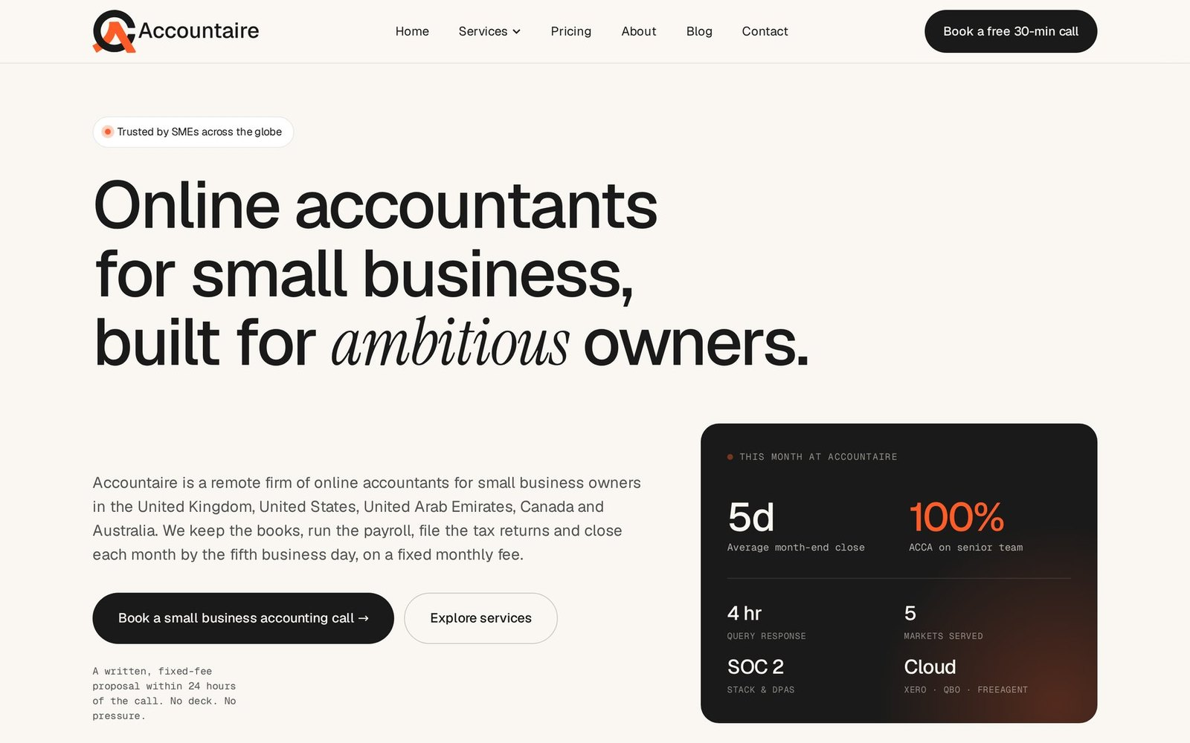

PLATFORM · WEBSITE
12 / 38
Accountaire
64 static pages migrated to a 74-page, five-market platform
accountaire.com
64
74
static pages in, CMS pages out
74 pages on Nuxt 4 + Strapi 5
Publish-to-live in one request
Five-currency pricing
llms.txt and markdown pages for AI engines
SEO/GEO COMPOSITE
49.6
to
88.1
USD
GBP
AED
CAD
AUD

Slide 13
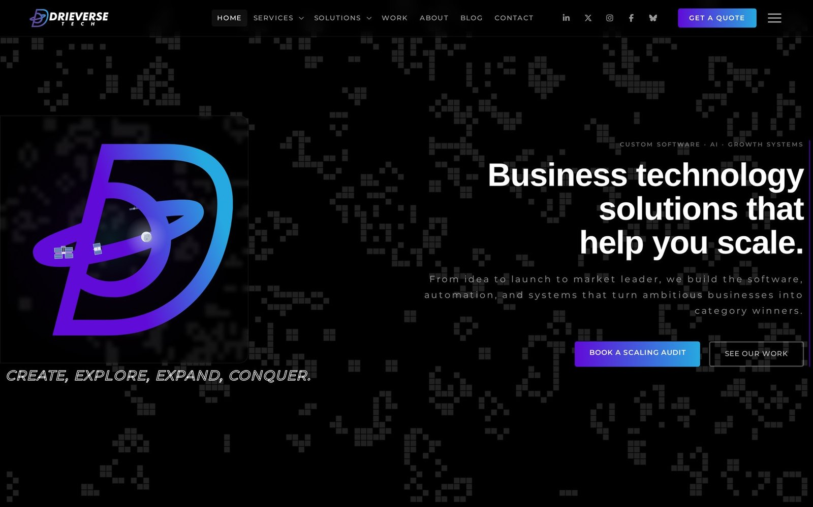
PLATFORM · WEBSITE
13 / 38
DrieVerse
A CMS that enforces publishing rules
drieverse.com
Nuxt 4 + Strapi 5
CMS blocks content that breaks the rules
Lead pipeline with rate limits, Turnstile, hashed IPs and fallback
Scheduled publishing and IndexNow
BLOCKED
Draft
Publish, checked against the site rules
Rate limit
Turnstile
Hashed IP
Fallback

Slide 14
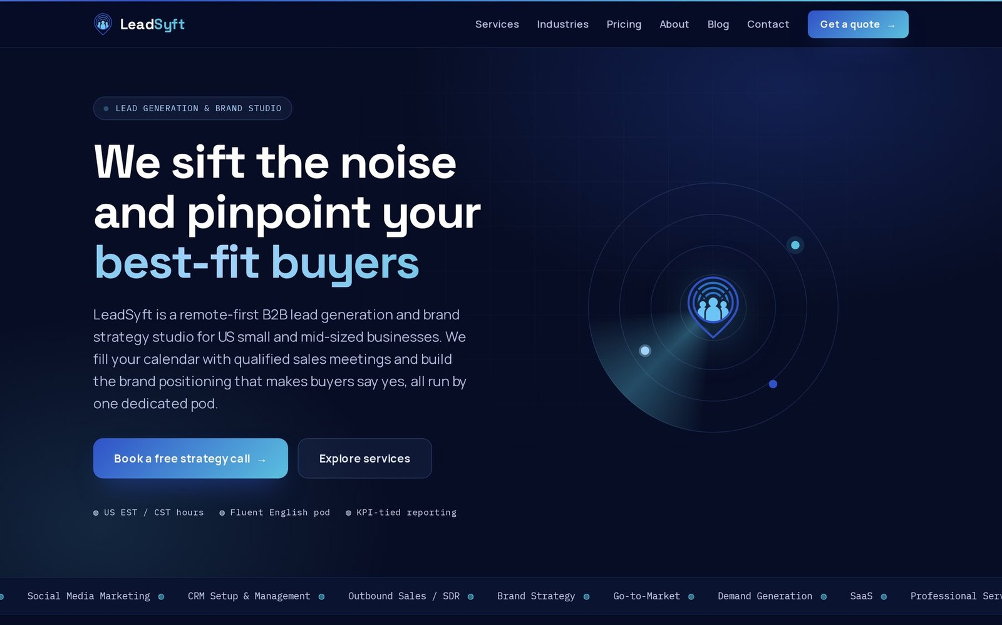
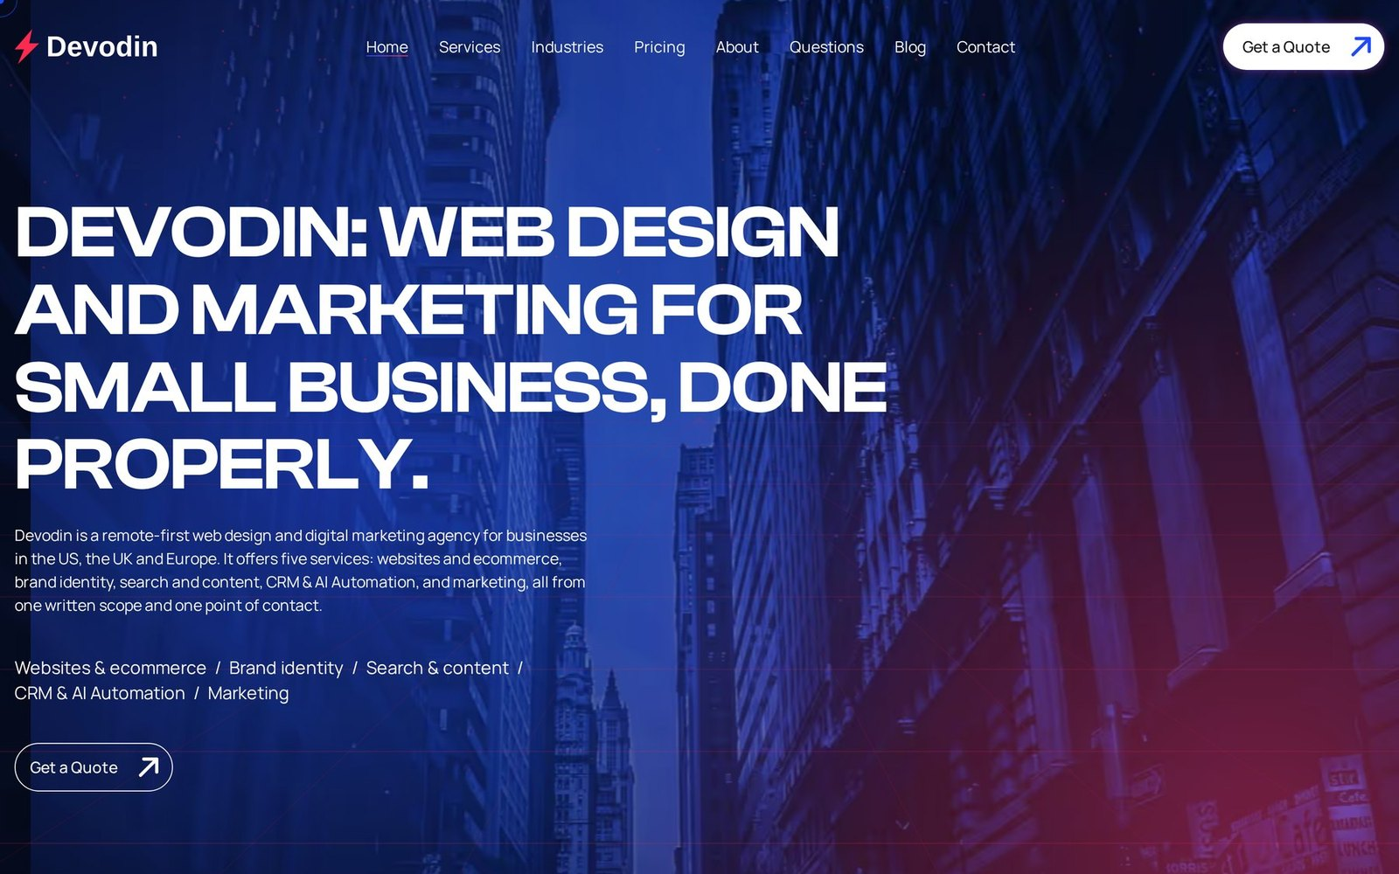
CLIENT PLATFORMS
14 / 38
Agency sites rebuilt for search and speed
LeadSyft leadsyft.com
DevOdin devodin.com
STACK
Next.js + Payload
LCP
2.19 s
1.03 s
PUBLISHING
without redeploy
PAGE WEIGHT
2,087 KB
470 KB
SEO AUDIT
47
80
SEO/GEO AUDIT
61
95

Slide 15
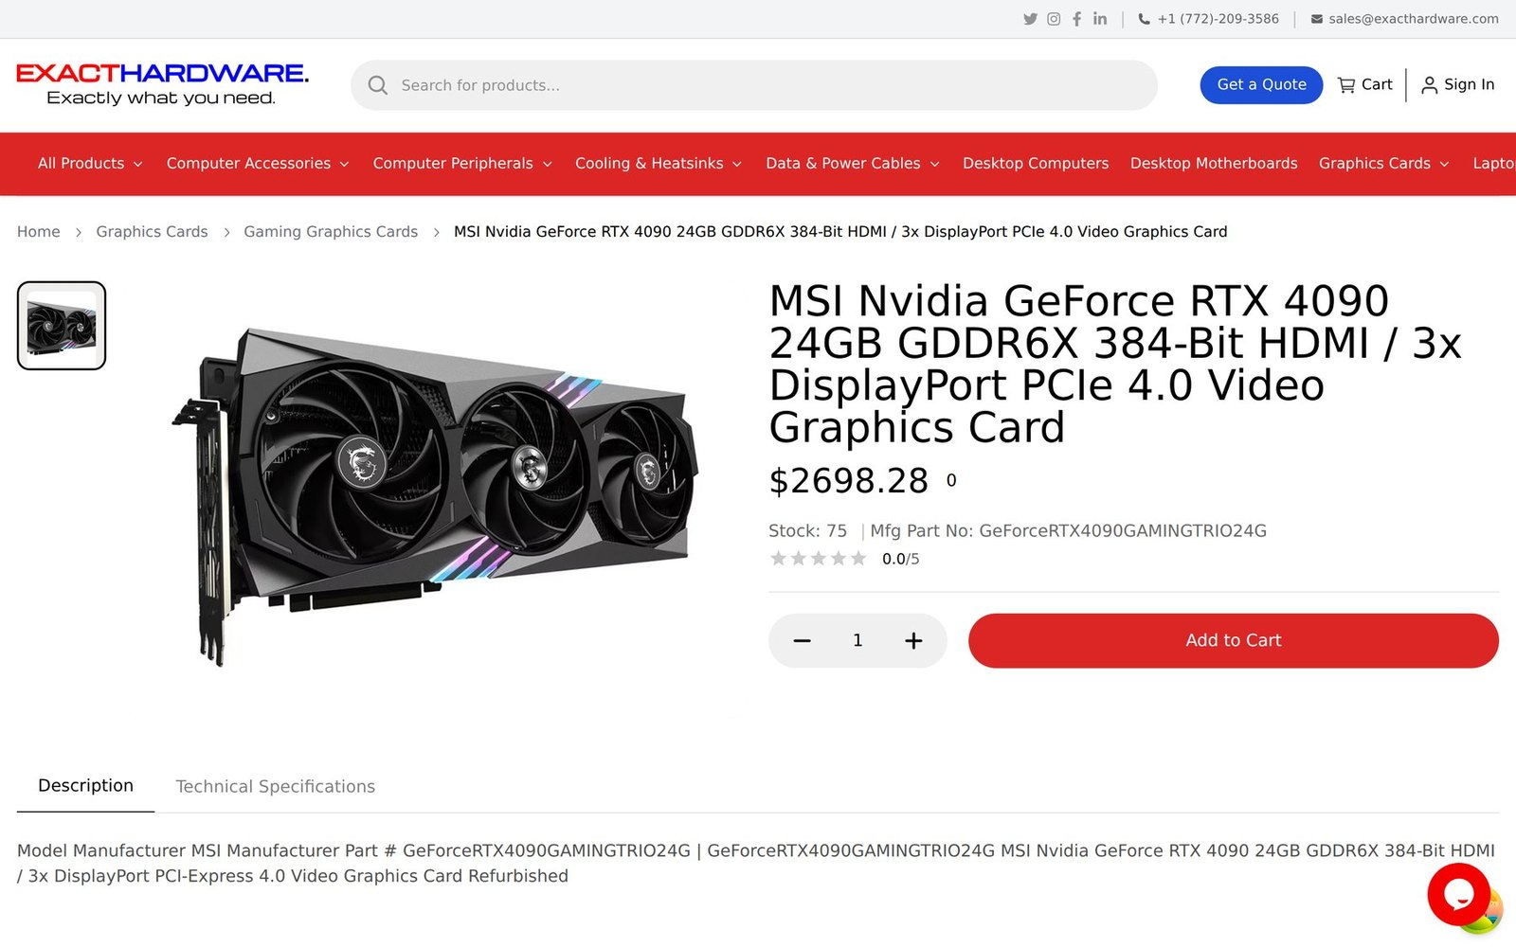
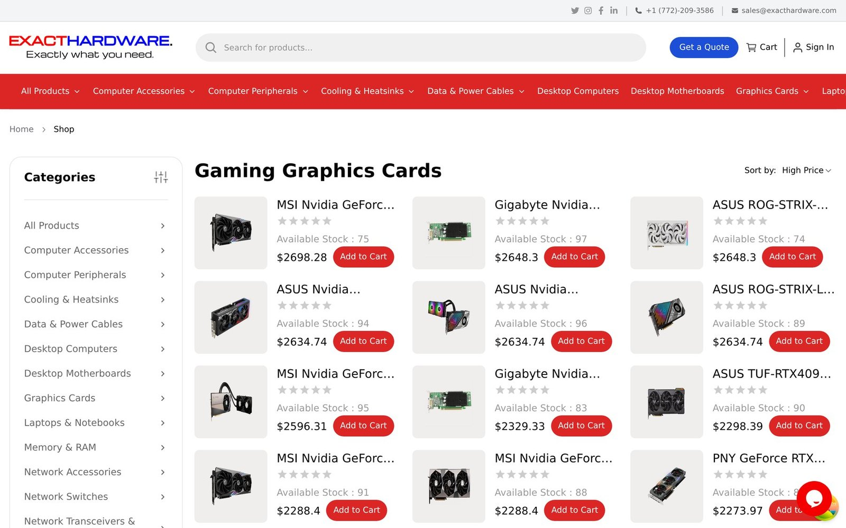
CLIENT PLATFORM · E-COMMERCE
15 / 38
Exact Hardware
A server-hardware store stocked by four distributor scrapers
exacthardware.com
Next.js 14 storefront and admin on self-hosted Supabase with Stripe
Python scraper with pausable, resumable jobs per distributor
Ansible-provisioned server
Production and staging pipelines
Distributor
Distributor
Supabase products
Python scraper
one process per job, resumable
Distributor
MinIO images
Distributor
Admin panel pause · resume

Slide 16
INFRASTRUCTURE
16 / 38
The self-hosted platform
47 containers hosting 10 sites, run by one engineer
Cloudflare, nginx, loopback-only apps
Shared Postgres, Supabase and per-app MinIO buckets
Cloudflare
GitHub push
Self-hosted Mailcow mail
PRODUCTION SERVER: 47 CONTAINERS, 10 SITES
nginx
2 self-hosted runners
Two self-hosted runners deploying 7 repos with health checks
18 site configs, Let's Encrypt TLS, loopback ports
GitHub Actions
sites include
abchaudary.me
DrieVerse
LeadSyft
Accountaire
Exact Hardware
SkillsVerx LMS
build and deploy 7 repos
health checks, smoke tests
SHARED DATA LAYER
PostgreSQL 17
Supabase
MinIO
Mailcow
four apps
14 containers
bucket per app
mail server, 18 containers
LMS live classes
DEVELOPMENT AND STAGING SERVER: 34 CONTAINERS
BigBlueButton
Staging stacks
OpenDesign workspace
live classes, 17 containers
for the products
behind authentication

Slide 17
PRODUCT · THIS SITE · ARCHITECTURE
17 / 38
abchaudary.me
A portfolio built and operated as a production system
abchaudary.me
REQUEST PATH
OWN SERVER
Next.js 16 + Payload CMS 3 in one process, on Postgres 17
Visitor
Cloudflare
nginx
Next.js 16 + Payload CMS 3
Self-hosted behind Cloudflare and nginx
proxy, DNS
TLS
one container
reverse proxy
pages, admin, API
Push-to-deploy on a self-hosted GitHub runner with a health gate and smoke test
PostgreSQL 17
MinIO
JSON-LD graph, llms.txt and a Markdown companion for every page
content
S3-compatible
media bucket
private network only
DELIVERY PATH
git push
GitHub Actions CI
Deploy job
to main
GitHub-hosted runner
self-hosted runner on this server
starts both
blocking gates
builds against the live database
in parallel
TypeScript, Vitest
ESLint, zero warnings
Playwright e2e, visual
database
Docker
compose
health
smoke
axe accessibility
migrations
build
up
check
test
Lighthouse CI budgets
bundle size
SEVEN BLOCKING CI GATES
TypeScript
ESLint at zero warnings
Vitest
Playwright on nine device profiles
axe
Lighthouse CI
Bundle size
7
9
9
18
blocking CI gates
device profiles
collections
decision records

Slide 18
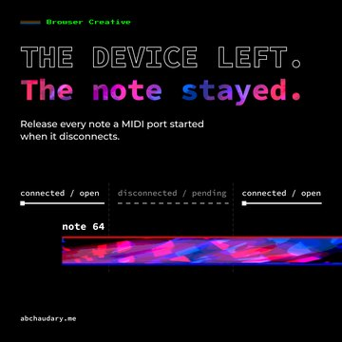
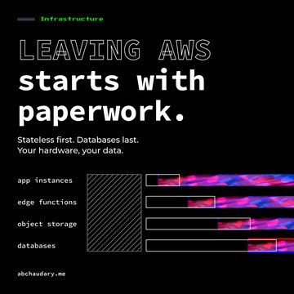
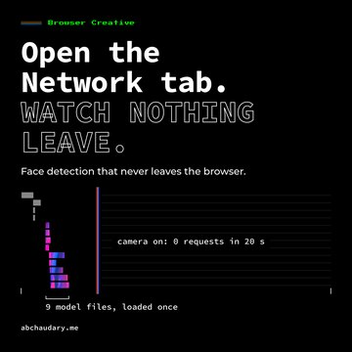
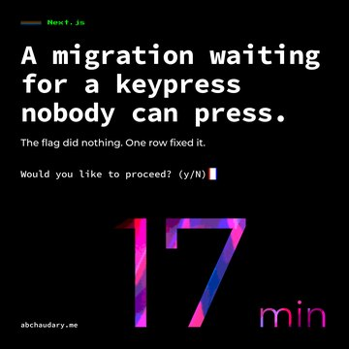
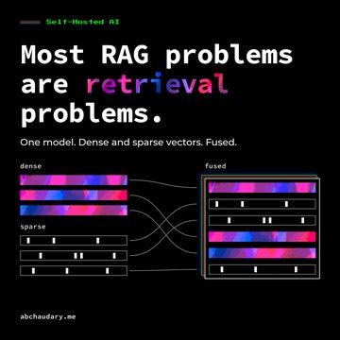
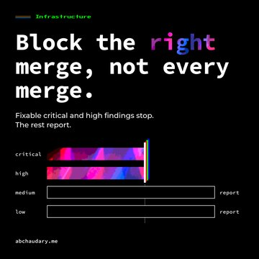
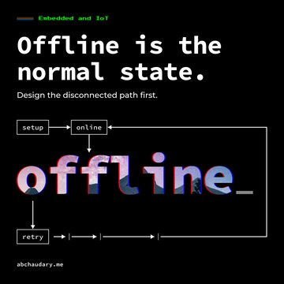
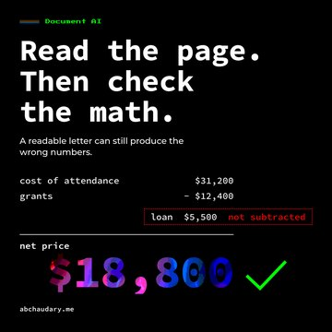
PRODUCT · THIS SITE · CONTENT PIPELINE
18 / 38
abchaudary.me
A mostly automated content pipeline, from evidence to distribution
Article draft
Campaign plan
Evidence and
QUALITY GATES
Payload CMS
4-week calendar
owner interview
voice rules
pushed as a draft
briefs
SEO / AEO / GEO
CAMPAIGN IMAGES, OPENDESIGN
Owner reviews
Social posts
Scheduled
OpenDesign imagery
and posts
LinkedIn, X, Bluesky
publishing
featured 16:9
distribution
written to the
Payload native
social squares
campaign sheet
Evidence from code and logs
OpenDesign imagery in 16:9 and 1:1
Keyword brief and cannibalisation check
Scheduled publishing by cron
My interview answers
Paste-ready LinkedIn, X and Bluesky sets
Draft pushed to the CMS unpublished
18 articles over four weeks
Optimisation, craft and image gates with a pass and fail scorecard

Slide 19
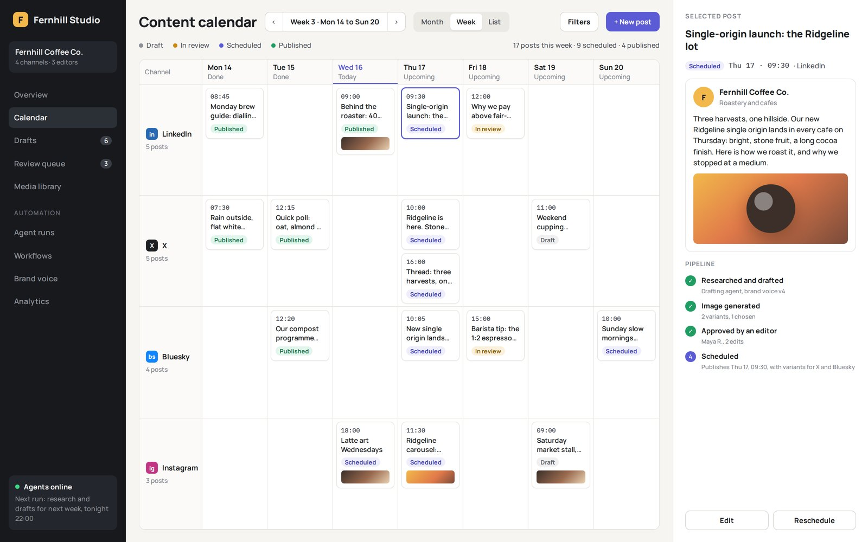
AUTOMATIONS
19 / 38
Agents that write, schedule and post, self-hosted end to end
Built for 10+ clients, and running 4+ of my own projects fully automated, on self-hosted, self-configured n8n, OpenCode, Hermes agents, OpenClaw and Postiz, with Claude, Codex and Gemini. n8n orchestrates, the agents do the multi-step work, the models are chosen per task, Postiz schedules and publishes.
results back into the next ideas
Idea and
Drafting
Image
Review
Scheduled
research
agents
generation
posting
human in the loop
multi-platform
Postiz
SELF-HOSTED, SELF-CONFIGURED STACK
ORCHESTRATION
n8n
Representative interface · fictional brand and copy
AGENTS AND TOOLS
OpenCode
Hermes agents
OpenClaw
Postiz
MODELS
Claude
Codex
Gemini

Slide 20
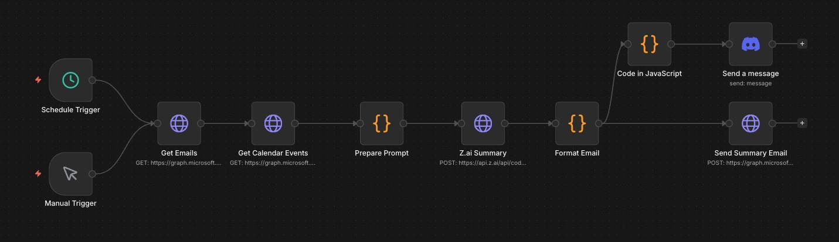
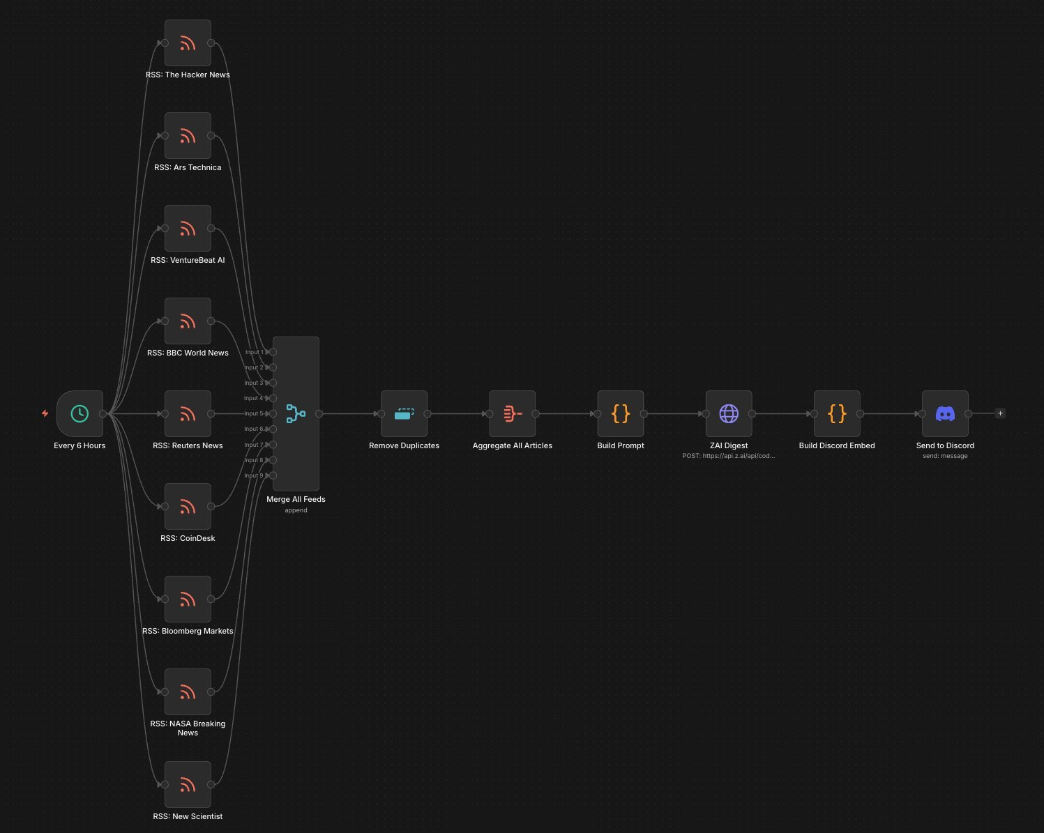
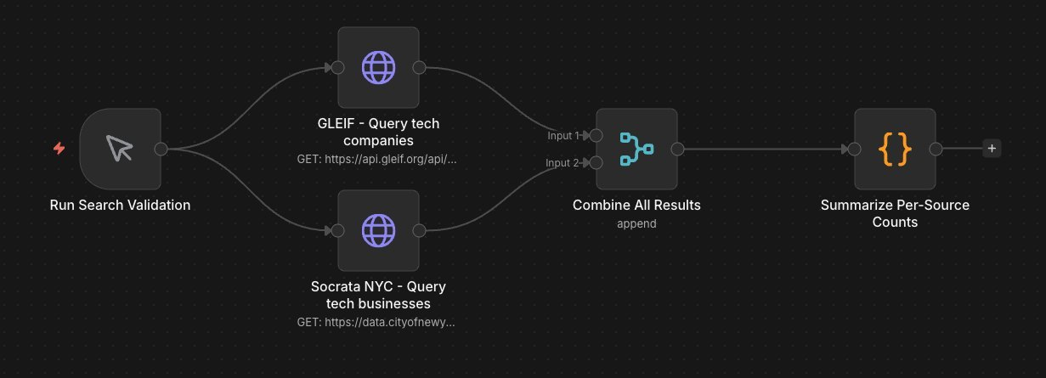
AUTOMATIONS · N8N
20 / 38
Personal n8n workflows: briefings and news digests
Work email and calendar via Microsoft Graph, summarised by an LLM, delivered to email and Discord
The same for my personal inbox
Nine news feeds every 6 hours, deduplicated and summarised into a Discord digest
Work email and calendar briefing
Open-data source validation for ACRM
every 6 hours
News digest
ACRM source validation

Slide 21
02
21 / 38
02
Pharma
Marketing research
Healthcare
EdTech
FinTech
Logistics
Real estate
Government
Business tools
Client engagements
Delivered under NDA and presented by industry. Product screens are representative mock-ups with fictional data.

Slide 22
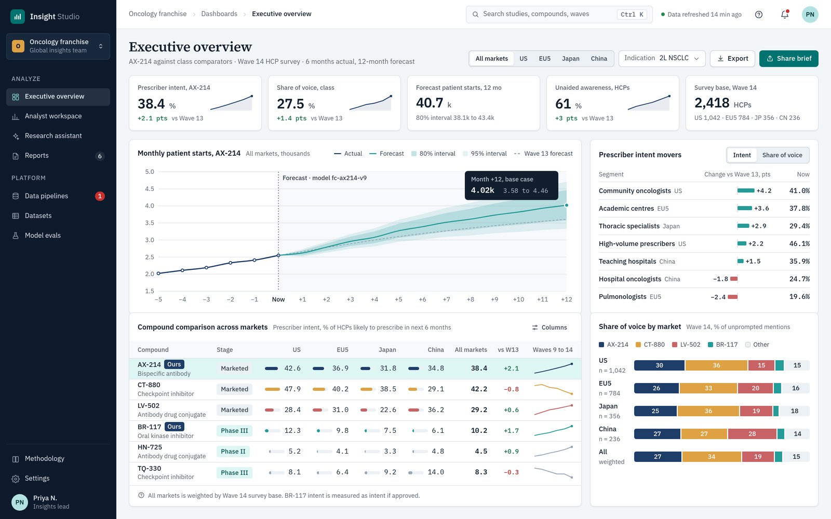
CLIENT WORK · AI · PHARMA, MARKETING RESEARCH, HEALTHCARE ANALYTICS
22 / 38
Pharma · marketing research · healthcare analytics
The AI platform that became the main selling point of a $600M+ acquisition
A pharmaceutical marketing-research company with huge research datasets, refreshed constantly, and four audiences: scientists, analysts, sales teams, executives. I wrote the winning proposal, architected the stack alone, hired two developers and led a team of four, about nine months from proposal to production.
Scientists
Analysts
Sales teams
Executives
NINE MONTHS, PROPOSAL TO PRODUCTION
Representative interface · client work under NDA
$600M+
Nine months
4
4 audiences
acquisition
proposal to production
a team of four
1 platform

Slide 23
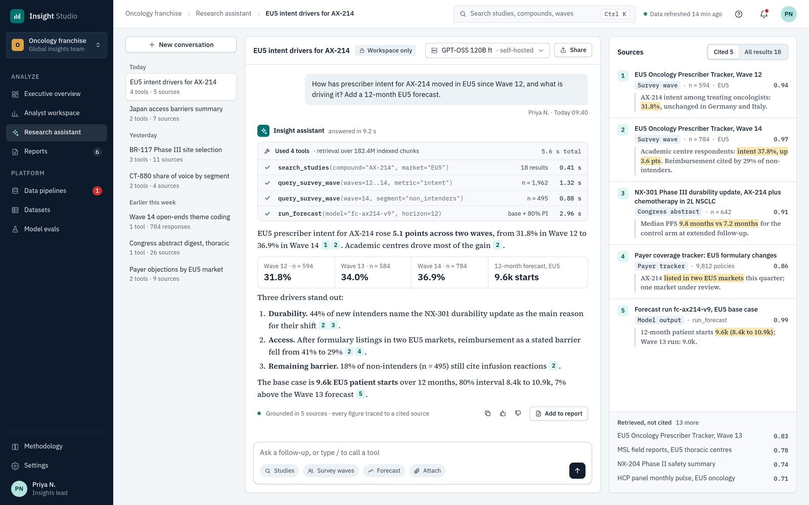
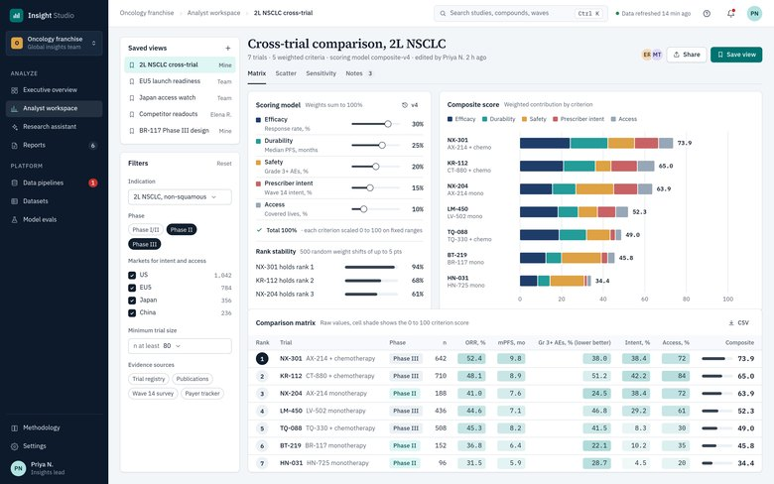
CLIENT WORK · AI · WHAT IT DOES
23 / 38
Pharma · marketing research · healthcare analytics
Data ingestion, evaluation math and RAG on self-hosted models
Ingests research big data from surveys and other sources
Evaluations and complex math: scoring, forecasting, comparison across trials, drugs and markets
LLMs and RAG behind a custom chat and evaluation engine with tool calling
Fine-tuned self-hosted GPT-OSS, Llama and Qwen
Vue front end, FastAPI AI microservice, self-hosted Supabase, scraping microservices
frequent refresh, large volumes
Research sources
Scraping and
surveys
ingestion
Cleaning and
Self-hosted
panel waves
normalisation
Supabase
trial registries
microservices
publications
Users
Evaluation and math
scientists
Dashboards and
scoring
Embeddings and
analysts
AI assistant
forecasting
RAG index
sales
comparisons across
executives
trials, drugs and markets
powers
powers
Fine-tuned models: GPT-OSS, Llama, Qwen
Representative interface · client work under NDA
self-hosted, open-weight

Slide 24
CLIENT WORK · AI · INFRASTRUCTURE
24 / 38
Pharma · marketing research · healthcare analytics
Cloud and colocation across providers, H100 then H200
APP TIER
AI TIER
Managed cloud and colocation spread across different providers
Users
public edge
Vue front end
NO PUBLIC ROUTE
scientists
reached only over the private 10 Gb network
GPU compute on a cluster of NVIDIA H100s, then H200 servers
analysts
private local
sales teams
App servers
10 Gb network
FastAPI
Chat and evaluation
App servers with 256 GB RAM, 48 cores and 96 threads on the latest AMD Ryzen, read-intensive SSDs
executives
AI microservice
engine, tool calling
256 GB RAM
48 cores / 96 threads
latest AMD Ryzen
read-intensive SSDs
Fine-tuned models
Every machine configured by me, hardware procurement included
RAG pipeline
GPT-OSS, Llama, Qwen
Self-hosted Supabase
self-hosted, open-weight
Ansible and Terraform
H100 cluster
moved to
H200 servers
Scraping microservices
NVIDIA, first tier
NVIDIA, current tier
HYBRID INFRASTRUCTURE
Managed cloud zone
Colocation zone
ACROSS PROVIDERS
tiers spread across both
PROVISIONING
Ansible and Terraform across every tier and both zones
256 GB
48 / 96
H100 then H200
RAM
cores / threads
GPU tier

Slide 25
CLIENT WORK · AI · SECURITY ARCHITECTURE
25 / 38
Pharma · marketing research · healthcare analytics
OpenAI, Anthropic, Meta, Google and AWS were reached. My servers were not.
A wave of AI supply-chain attacks reached the biggest names in the industry. I had designed this platform’s security so its model servers had no public route at all: the AI tier talked to the app server only over a private 10 Gb link that I architected and configured. Security designed in from the first diagram, not bolted on after the breach.
REACHED
OpenAI
Anthropic
boundary: app tier only
Meta
PUBLIC INTERNET
App server
public edge
AI tier
model servers
no public route
private 10 Gb
Google
AWS
OUTCOME The product became the main selling point of the client’s $600M+ acquisition.
0
10 Gb
5
0
public routes to the AI tier
private link
industry giants reached
reached here

Slide 26
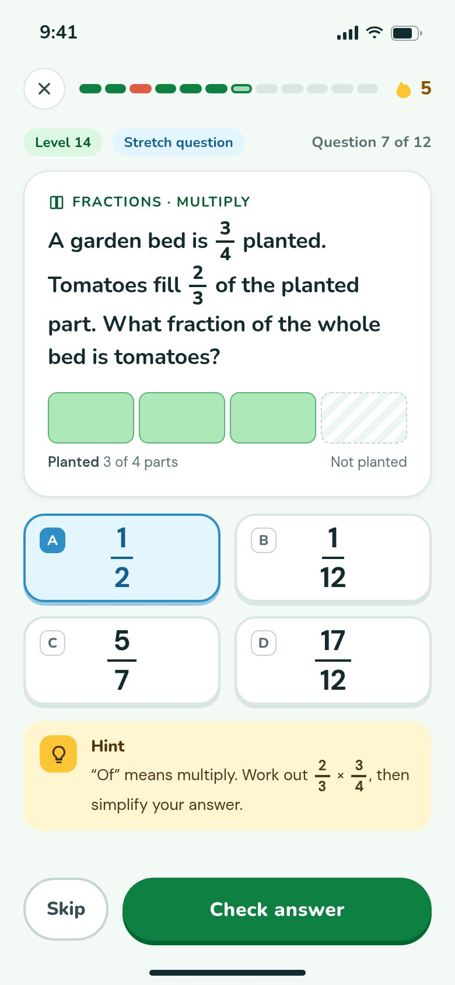
CLIENT WORK · EDTECH, EDUCATION PARTNERSHIPS, SUBSCRIPTIONS AND BILLING
26 / 38
EdTech · education partnerships · subscriptions and billing
One app on web, iOS and Android for schools on several continents, and a cloud migration that cut infrastructure cost about 70%
One React Native app for web, iOS and Android on a Flask backend
Adaptive levels, competitions, progress tracking, teacher views, white-labelling, per-seat selling
App Store server
Apple in-app billing on iOS, Stripe on web, entitlement across devices
iOS app
Apple
notifications
Entitlement record
in-app purchase
purchase / renewal events
per account
per-seat licences
Tens of thousands of students in schools in different countries and continents
for schools
AWS to my self-hosted secure private cloud, about 70% cheaper, zero downtime
One entitlement
service
I led the team and ran infrastructure, pipelines, GitLab, Jira, WordPress sites and Microsoft 365
Flask backend
React Native app
the same app unlocks on
Web app
Stripe checkout
Stripe webhooks
iOS
Android
Web
purchase / renewal events
Representative interface
client work under NDA
BEFORE
AWS
primitive setup
migration
AFTER
Self-hosted secure private cloud
About 70% lower infrastructure cost, zero downtime

Slide 27
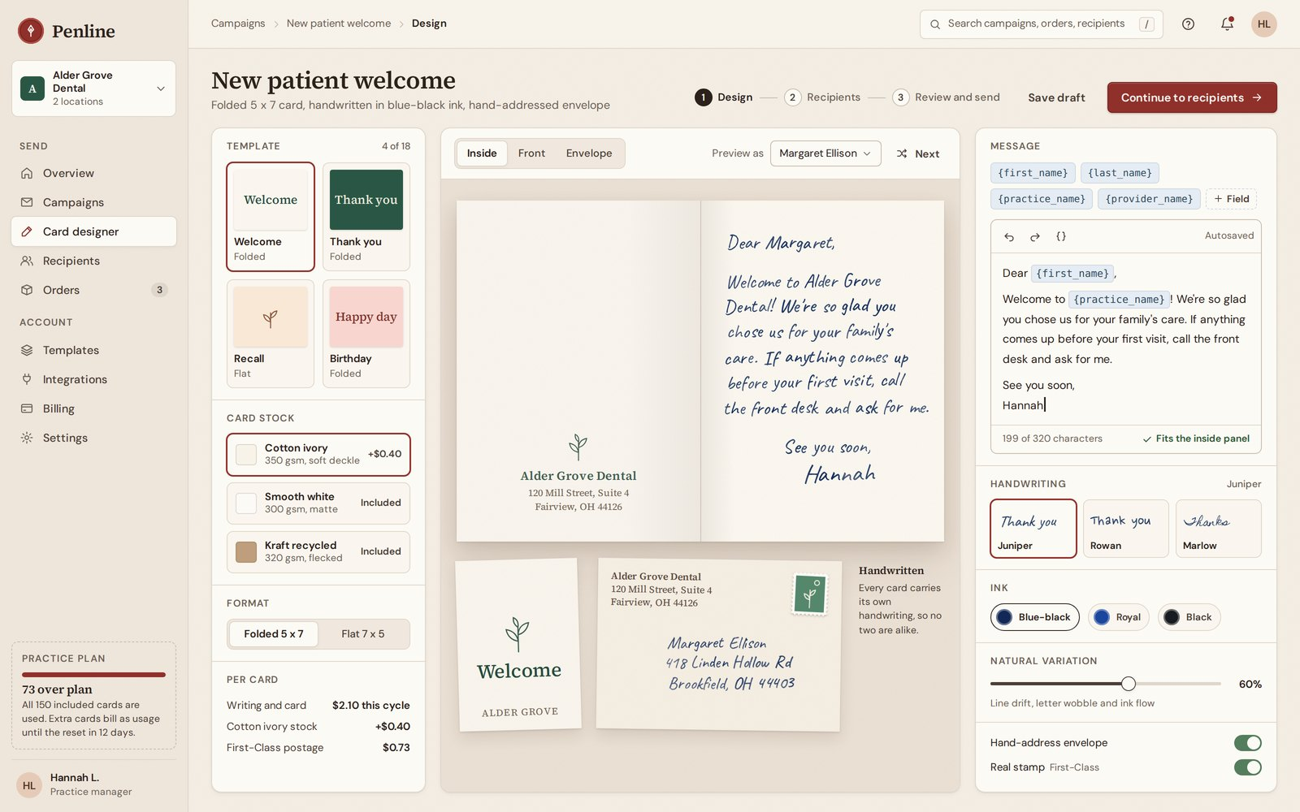
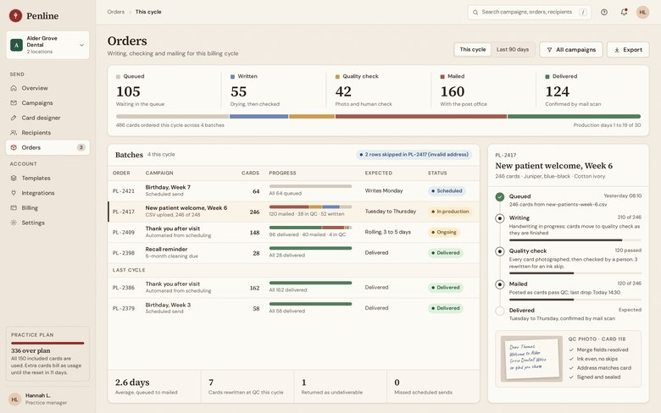
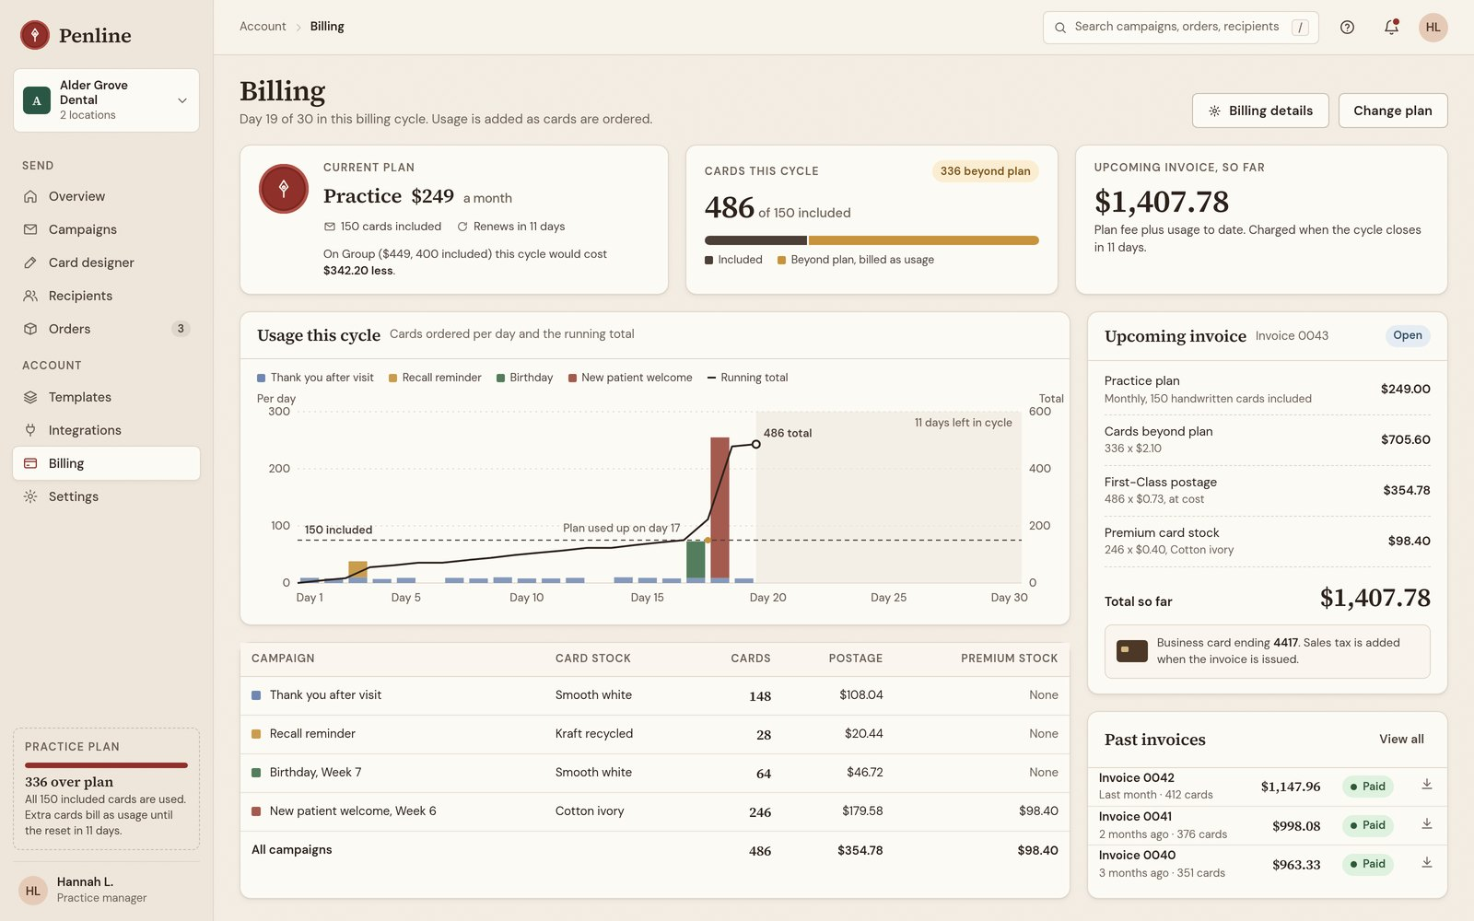
CLIENT WORK · HEALTHCARE, BUSINESS TOOLS, MARKETING AND CUSTOMER ENGAGEMENT
27 / 38
Healthcare · business tools · customer engagement
Bulk handwritten and printed mail, automated from order to mailbox
Businesses, healthcare above all, send handwritten and printed letters and cards in volume. I automated ordering, making and sending
Monthly subscriptions with dynamic billing
Vue front end, Express back end, MongoDB, all hand-coded
I led the whole design team on the front end and wrote the proposal that won the client
status back to the customer
Customer order
Card design
Production
Mailing
Tracking
recipient list
template
handwriting
stamped
queued
CSV upload
message
or print
sorted
written
address validation
merge fields
quality check
posted
mailed
handwriting or print
delivered
usage metered from the pipeline
BILLING, ALONGSIDE THE PIPELINE
STACK
Dynamic usage billing
Vue front end
Monthly subscription
Express API
plus
MongoDB
the plan
cards beyond the plan
postage
premium stock
GitLab CI/CD
staging and production
Representative interface · client work under NDA

Slide 28
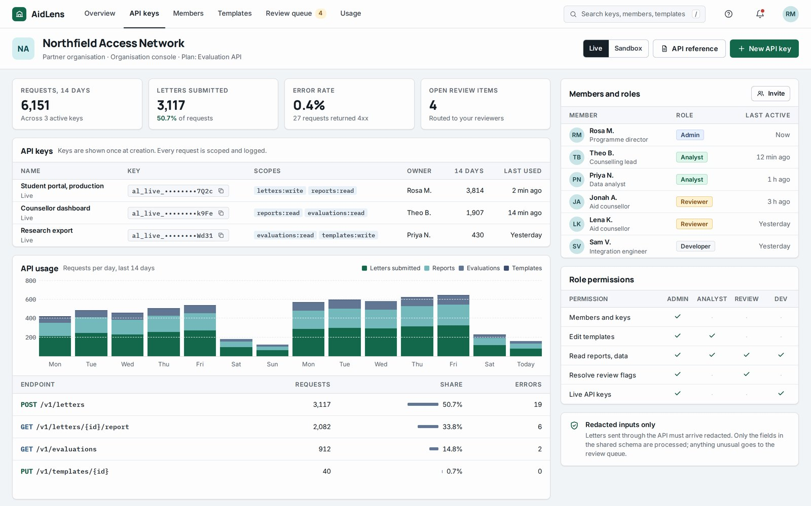
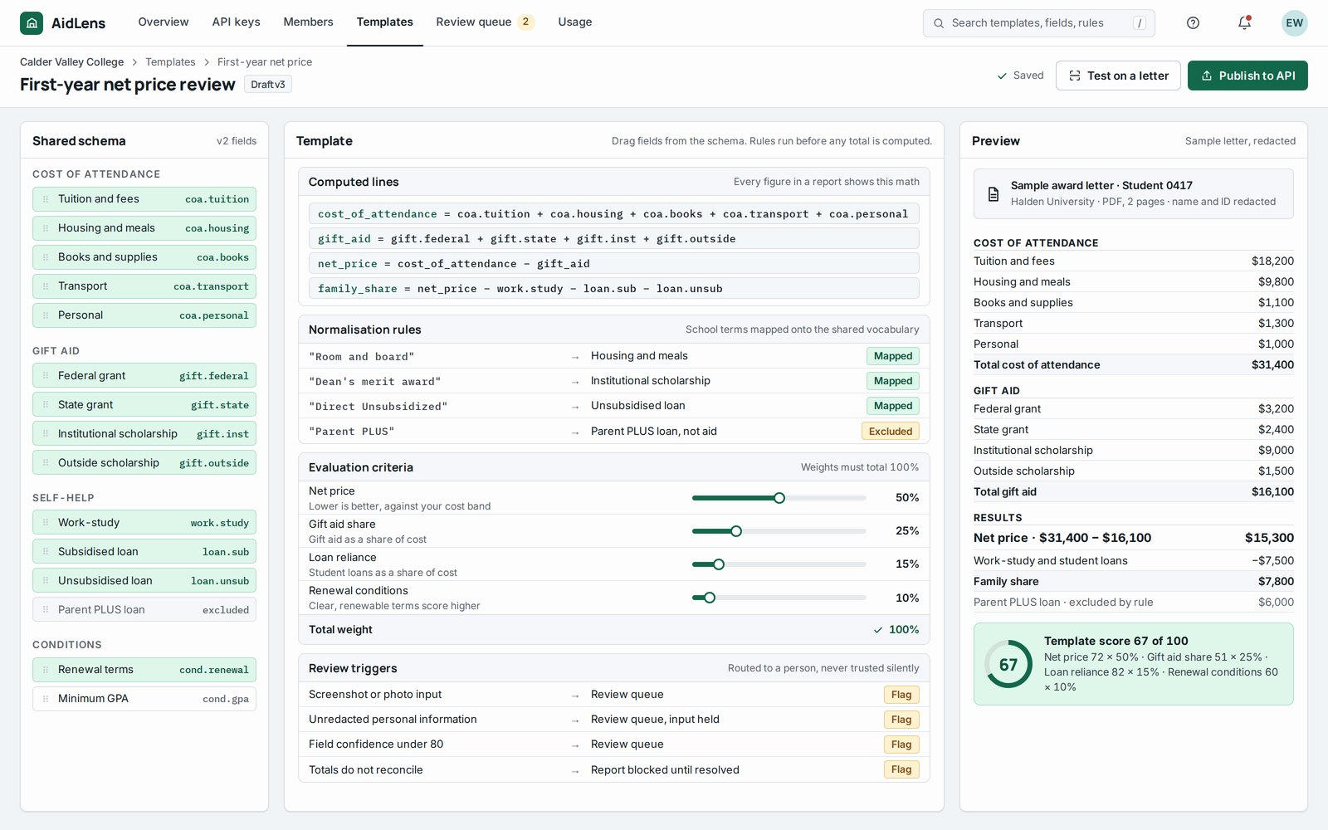
CLIENT WORK · EDTECH, HIGHER EDUCATION, FINTECH, DOCUMENT AI
28 / 38
EdTech · higher education · FinTech · document AI
A multi-role API platform for evaluating college award letters
The platform serves an API so other educational organisations can use its data to create their own evaluations
A front-end implementation of that API where students evaluate their own college award letters
Vue, FastAPI and the Claude API (Claude Sonnet), with plans to self-host the models
reports and data back through the API
A separate demo and upsell app on Vue, Express and MongoDB with its own CI/CD
THE PLATFORM
Institutions
Platform API
FastAPI intake
and partner
API keys and roles,
redacted inputs,
I owned the proposal and client onboarding
organisations
their own evaluations
specified fields only
Claude OCR
extraction into
Review queue
a strict schema
a person checks
screenshots,
unredacted personal
Normalisation
information and
and reconciliation,
pipeline issues
Students
Web front end
sums must add up
letters in any format,
Vue, compressed
screenshots too
in the browser
Reports and data
report
the math behind
every figure
Representative interface · client work under NDA
Vue · FastAPI · Claude API (Claude Sonnet)

Slide 29
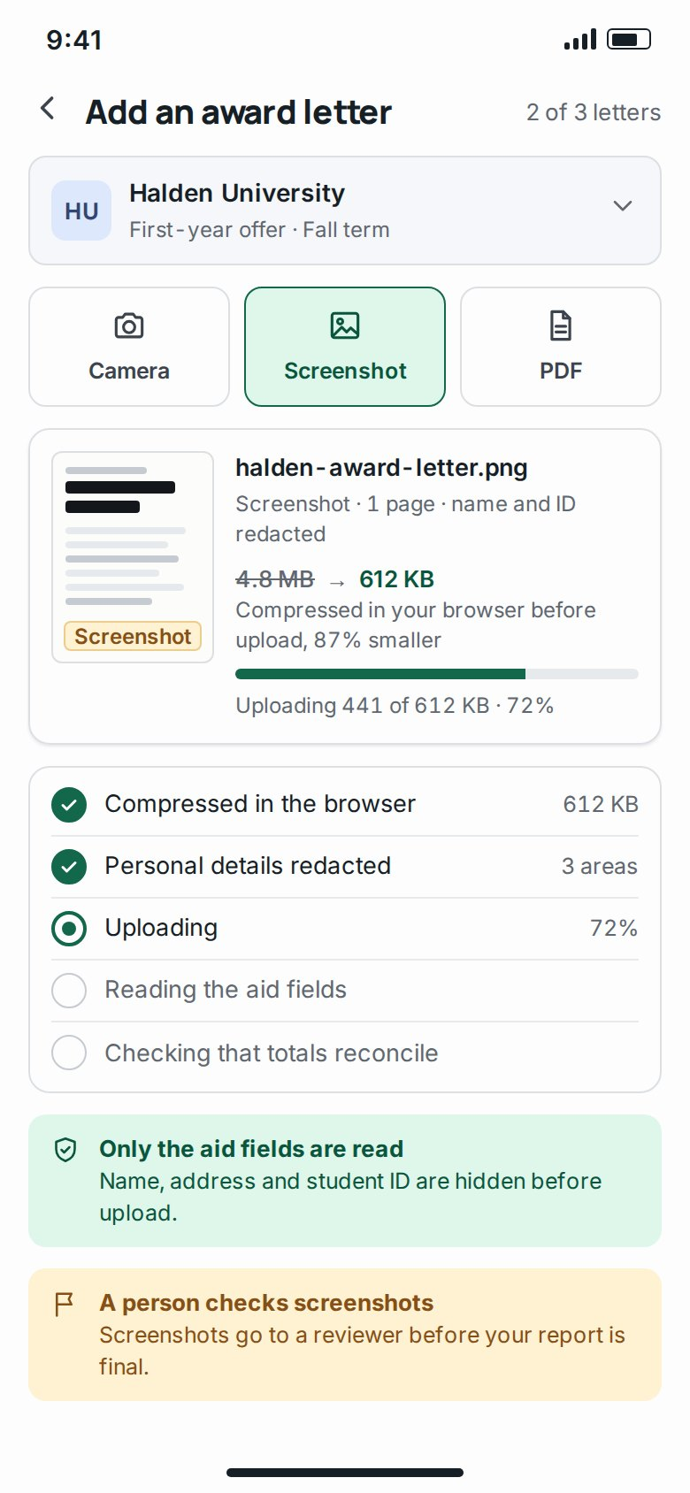
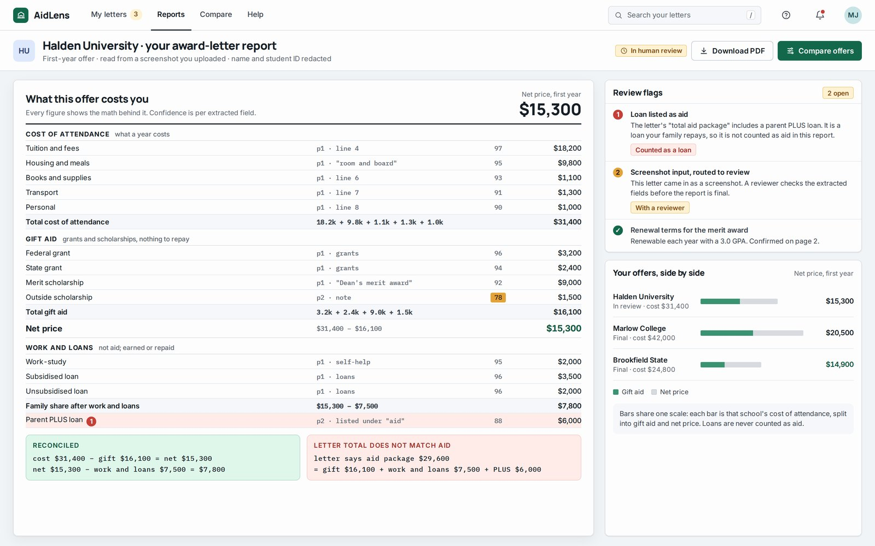
CLIENT WORK · EDTECH, HIGHER EDUCATION, FINTECH, DOCUMENT AI
29 / 38
EdTech · higher education · FinTech · document AI
Extraction, normalisation, reconciliation and human review
abchaudary.me/blog/claude-api-ocr-financial-aid-letters
Upload
compressed in the browser
Intake
FastAPI, redacted inputs
OCR and extraction
Claude API, strict schema
Comparison
normalise, reconcile
Report
the math behind every figure
Review
flagged, routed to a person
Letters arrive in any format, including phone screenshots, and are compressed in the browser before upload
FastAPI and Claude OCR read only the specified fields from redacted inputs into a strict shared schema
Rules normalise each school’s terms
Sums must reconcile and the report shows the math behind every figure
Screenshots, unredacted personal information and pipeline issues are flagged and routed to human review
Representative interface
client work under NDA
Representative interface · client work under NDA

Slide 30
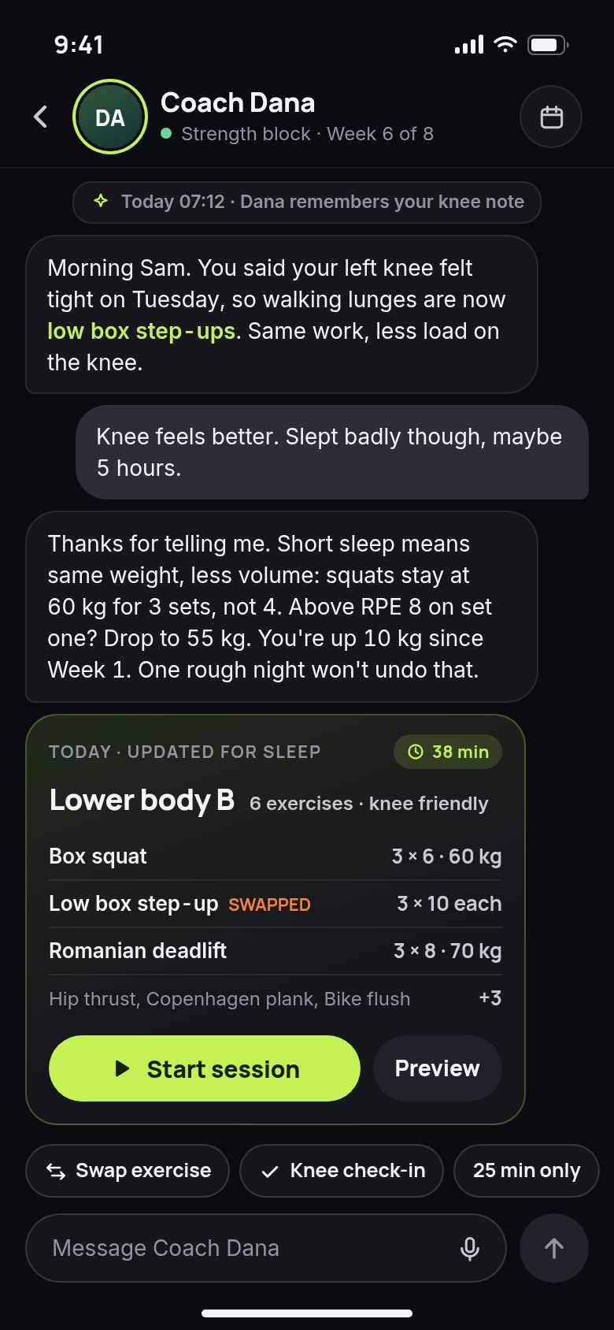
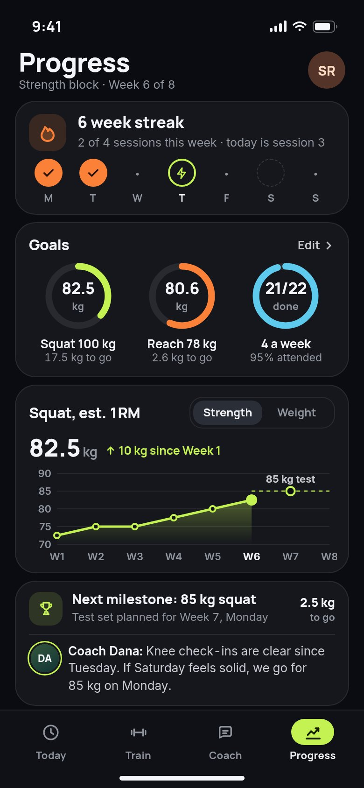
CLIENT WORK · COACHING AND CONSUMER AI
30 / 38
Coaching · personal training · consumer AI
An AI coach that keeps a personal trainer’s voice
A chat app that coaches users in life and professionally in a personal trainer’s voice
VOICE, ENFORCED IN THREE LAYERS
The voice is held by prompting, retrieval over the trainer’s own content and fine-tuning
Prompting
layer one
Memory of each user and goal tracking
Vue, Express, MongoDB and GitLab CI/CD for staging and production
Retrieval
layer two, over the trainer's own content
Fine-tuning
layer three
Memory
of each user
Representative interface · client work under NDA
Goal tracking
each user's goals

Slide 31
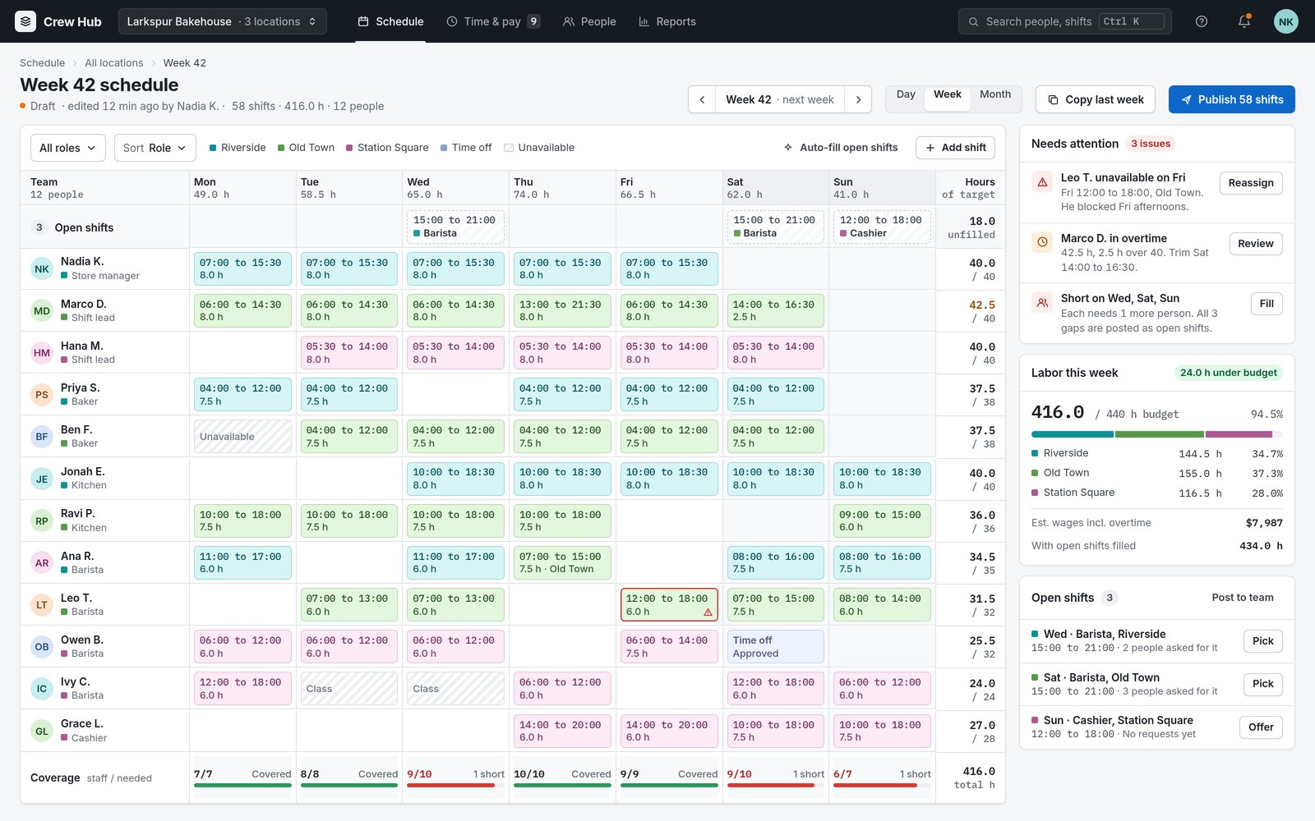
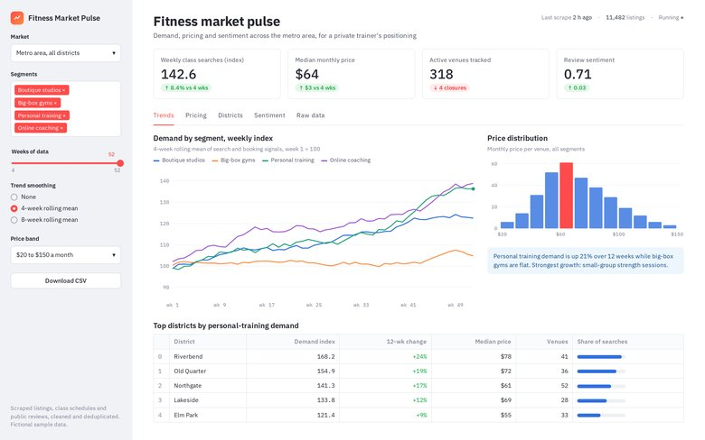
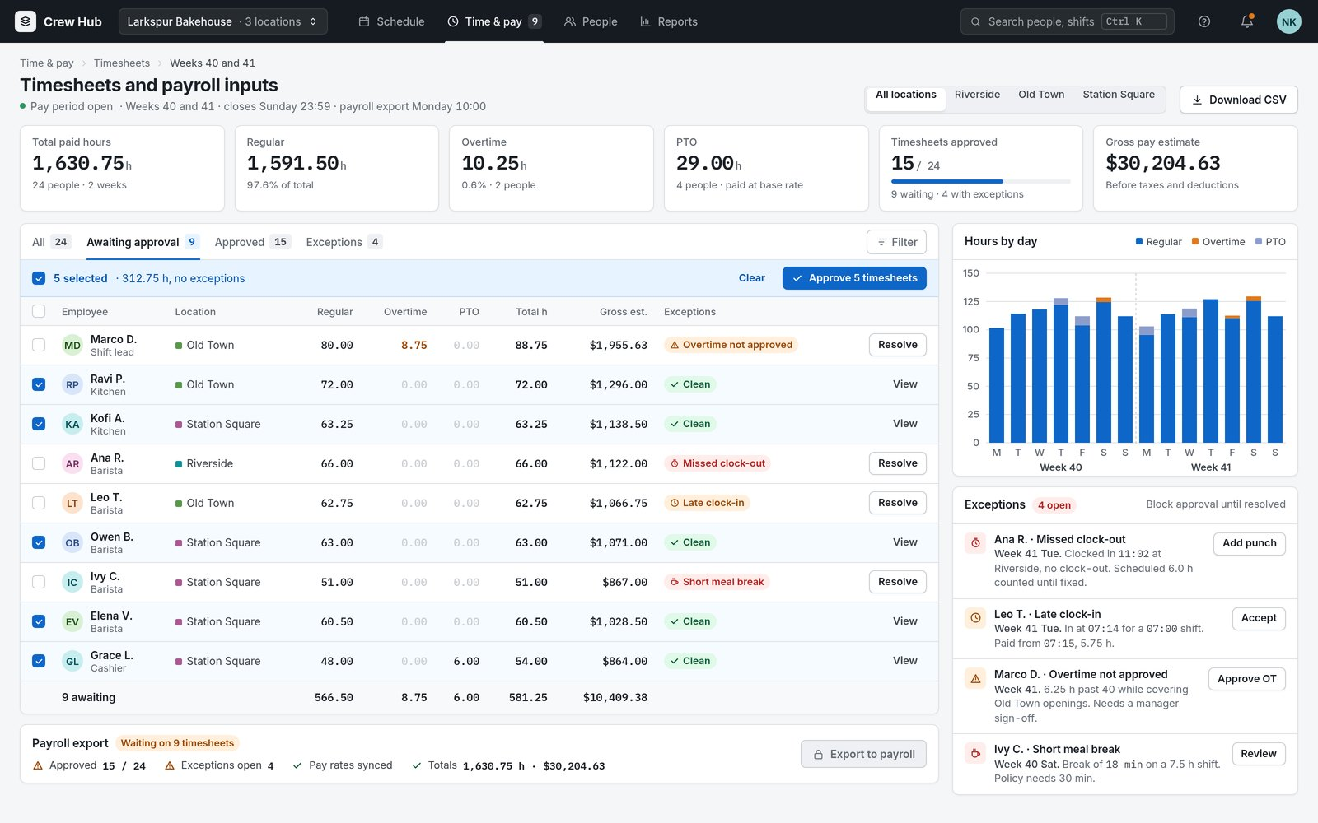
CLIENT WORK · ACROSS VERTICALS
31 / 38
Migrations · workforce tools · data
Migrations, workforce tools and fitness analytics
Client platforms migrated onto new infrastructure with their servers and data exported across
Workforce tools for scheduling, time tracking, payroll inputs and dashboards
Fitness-market analytics from scraped data to Streamlit dashboards
Old servers
the existing client platform
Data export
servers and data exported across
New servers
new infrastructure
Representative interface · client work under NDA
Representative interface · client work under NDA
Verification
checked before the cutover
Switchover
traffic moves to the new servers

Slide 32
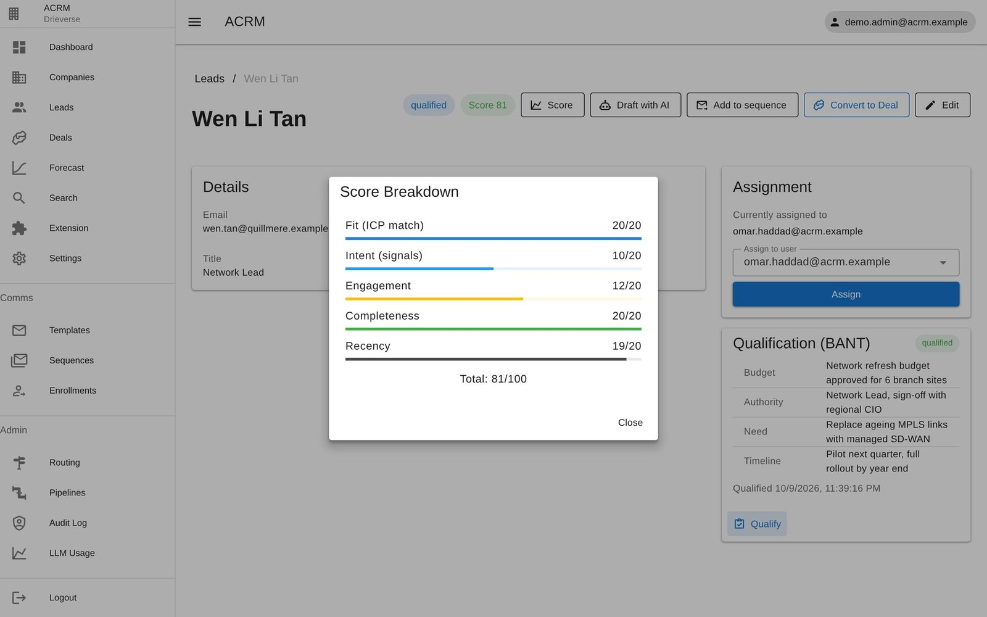
03
32 / 38
03
Earlier professional work
Enterprise suite
CRM, CMS, accounting and HRMS suite with 3x release frequency
IoT smart farming
From ESP32 firmware to dashboard
Early portfolio
33+ apps and 40+ sites
ACRM, seeded fictional data
ACRM: lead search across 12 sources and 28 collectors, enrichment, 0 to 100 scoring and routing for 7 business lines in 10 countries

Slide 33

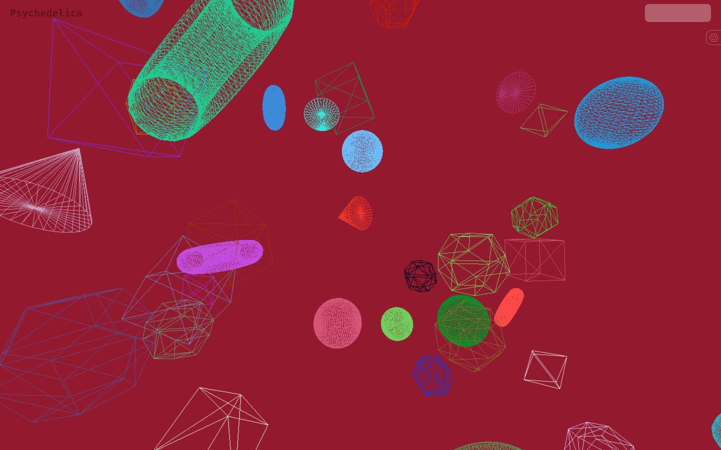

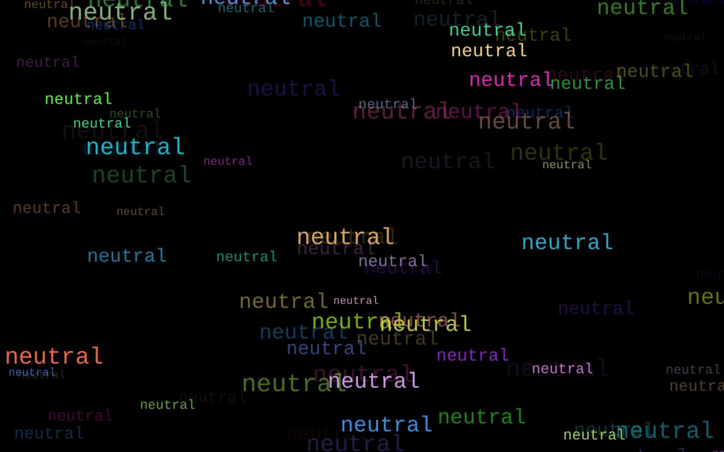
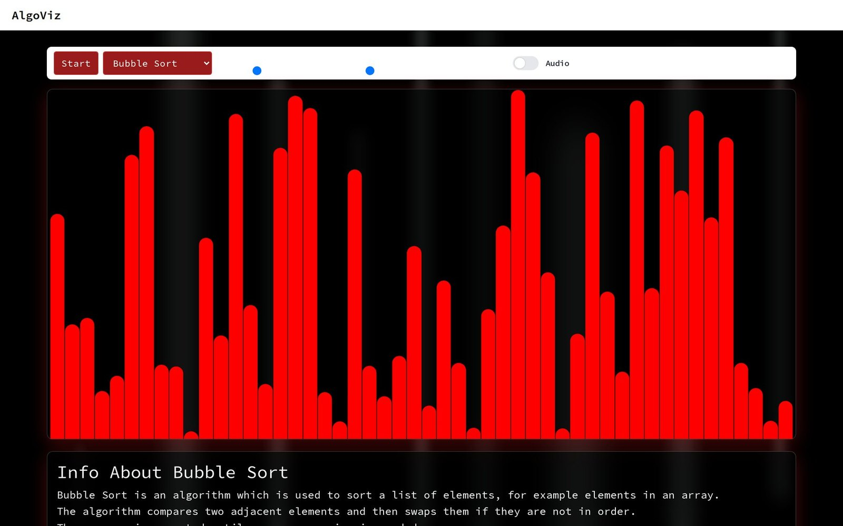
04 · LIVE IN THE BROWSER
33 / 38
Real-time graphics, audio and on-device ML
MusicGen musicgen.abchaudary.me
Psychedelica psychedelica.abchaudary.me
AudioViz audioviz.abchaudary.me
All at *.abchaudary.me
Emotions AI emotions-ai.abchaudary.me
AlgoViz algoviz.abchaudary.me

Slide 34
EXPERIENCE
34 / 38
Experience: four roles
01
Fuentes Tech
$600M+ acquisition product · 99.95% uptime
Principal Full-Stack Engineer & DevSecOps Architect
02
DrieVerse Tech
20 people across 5 concurrent products
Development & Technical Lead
03
Intersoft AI
3x release frequency
Full-Stack Engineer & Systems Expert
04
Freelance
33+ apps, 40+ websites and stores
Full-Stack Developer

Slide 35
EDUCATION · CERTIFICATIONS · IMPACT
35 / 38
Credentials and results
99.95%
45%
80%
uptime
lower cloud spend
fewer critical vulnerabilities
~70%
95%
3x
lower infrastructure cost
on-time delivery
release frequency
EDUCATION MS and BS Computer Science, The Superior University
CERTIFICATIONS CCNP Routing & Switching, CCNP Security

Slide 36
CORE SKILLS
36 / 38
Technical skills by group
LANGUAGES
AI/ML
Python, JavaScript, TypeScript, PHP, C/C++, Bash, SQL
LLMs, RAG, vector databases, Qdrant, Ollama, Qwen3, BGE-M3, MCP, agentic workflows, n8n, prompt engineering, TensorFlow, Pandas, scikit-learn
FRONTEND
Next.js, React, React Native, Vue.js, Nuxt.js, Tailwind, Vuetify, Three.js, GSAP
AI CODING TOOLS
Claude Code, Cursor, Cline, Gemini CLI, GitHub Copilot, AGENTS.md and rules-file conventions
BACKEND
Django, FastAPI, Flask, Express, Node.js, Laravel, REST, GraphQL
DATASTORES
PostgreSQL, MySQL, MongoDB, Redis, Elasticsearch, Supabase
CLOUD AND DEVOPS
AWS (EKS, Lambda, RDS, S3, CloudFront, IAM), GCP, Azure, Docker, Kubernetes, Helm, ArgoCD, GitOps, Terraform, Ansible, GitHub Actions, GitLab CI/CD, Linux, Nginx, VMware, Proxmox, self-hosted cloud, SRE
SECURITY AND NETWORKING
IAM, HashiCorp Vault, VPC, VPN, TLS, OWASP, SIEM, WAF, SSO, OAuth2, SAST/DAST, Trivy, Snyk, fail2ban, UFW, Cloudflare
EMBEDDED
ESP32/ESP8266, Zephyr RTOS, BLE, MQTT, circuit design
OBSERVABILITY
Prometheus, Grafana, ELK, OpenTelemetry, Loki

Slide 37
WHY WORK WITH ME
37 / 38
Ownership, security, production AI and leadership
01
End-to-end ownership, from proposal to uptime
02
Security designed in from the start
03
AI that ships to production, self-hosted when it must be
04
A leader who still writes code

Slide 38
CONTACT
38 / 38
Get in touch
Available for senior full-stack, DevSecOps, AI and technical leadership roles.
EMAIL abchaudary@outlook.com
LINKEDIN linkedin.com/in/abchaudary
SITE abchaudary.me

